Slide 1
Team grnn
En kort presentasjon av oblig 4
Agnete Gridseth Røstad
Alise Haukenes
Amund Lindstøl
Eivind Dagsland Halderaker
Helge Mikael Landro
Håkon Ettestøl Osland
Magnus Flatheim Jensen
Lord Simon Lord Telle Lord Riple
Notes:
1

Slide 2

Main Results
Refractoring (buttons and stages)
Animations
Online player statistics
Sounds
Login for player2
Diagrams/Documents
Better communication on slack
Better at git issues
Bug fixes

Slide 3
Challenges and Solutions
Challenges
Solutions
3 team members were gone for 3 days
Spaghetticode resulted in issues due to castling moving 2 pieces at the same time
Pair-programming, time and communication

Slide 4
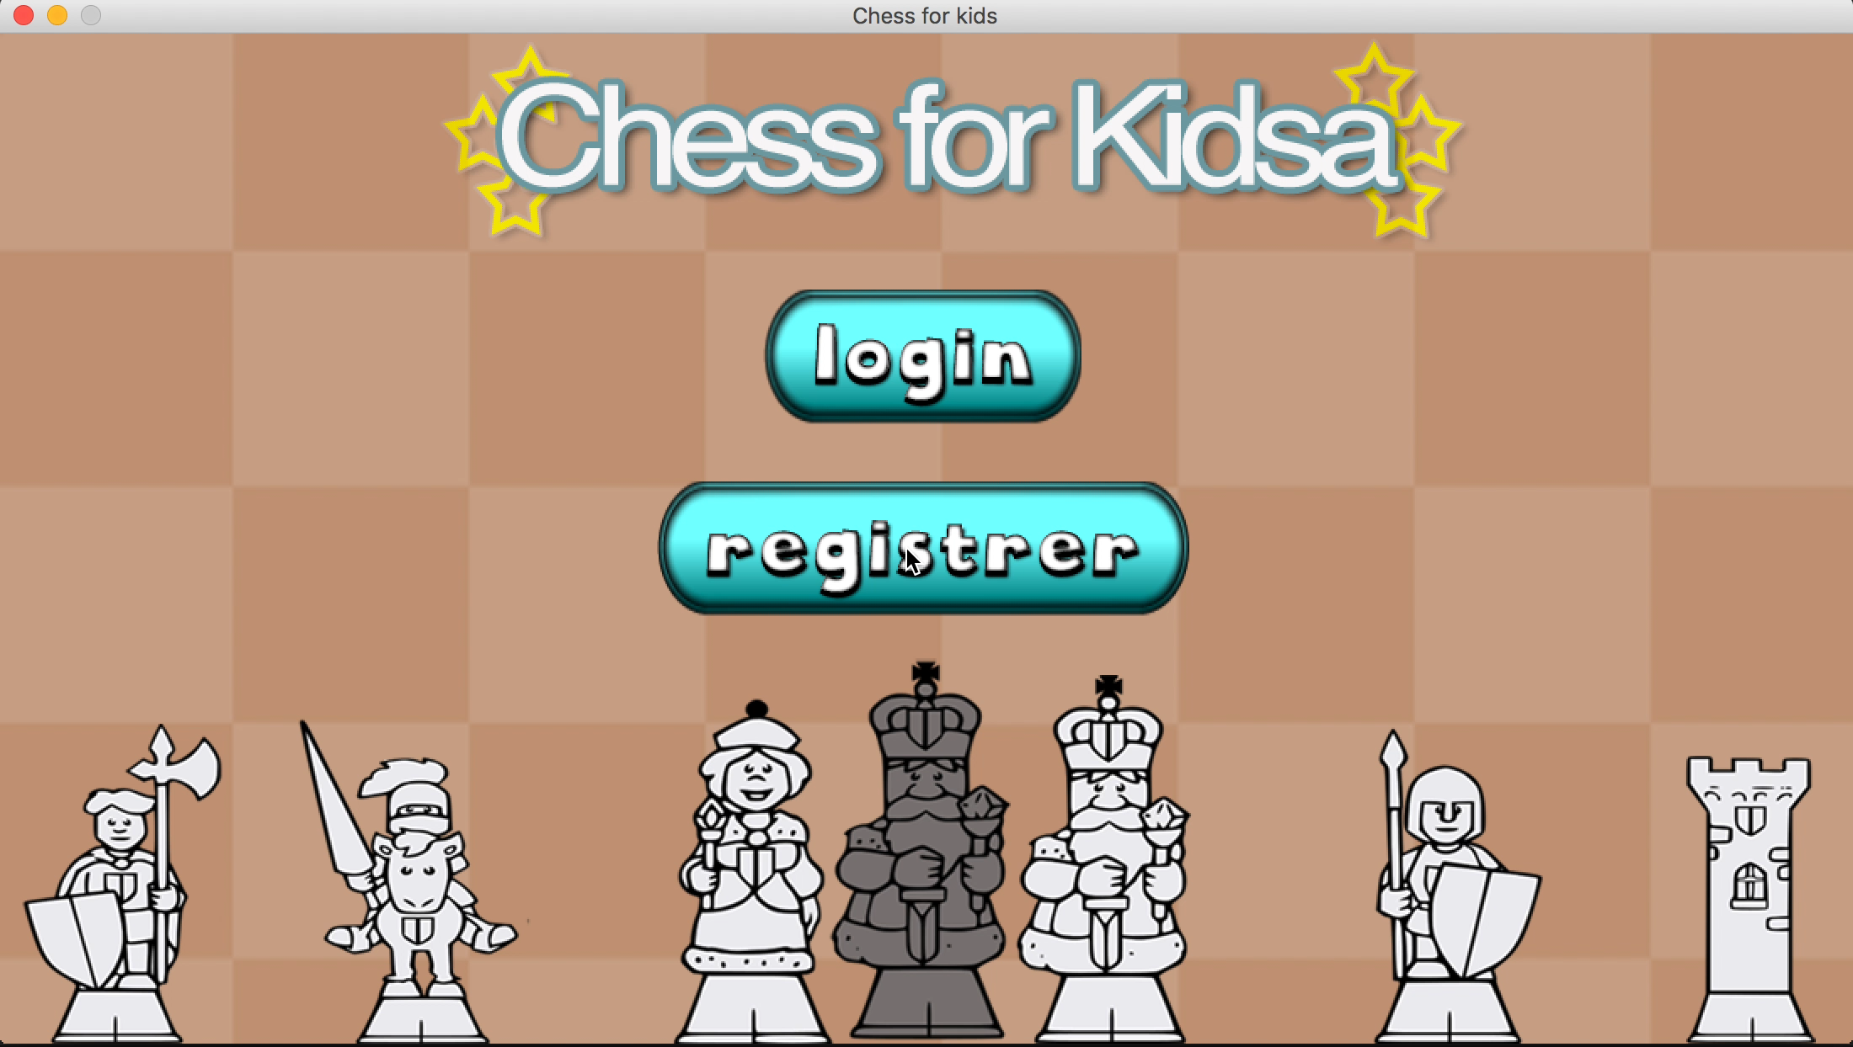

Slide 7
Retrospektiv
What went well?
Refractoring
Cool animations
Scrum
What could’ve gone better?
Having a up-to-date backlog
Communication
Assignment of tasks
Creation of tasks
Git issues
Tests

Slide 8
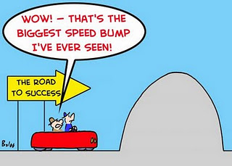
Veien videre
Fix AI
Improve random AI

